Slide 1
BUDGET
BEAT
Dinko Filev
Tancho Mihov

Slide 2



Who we are?
Dinko
Tancho

Slide 3

What did we do?
Budget your finances to know where your money is going. Budget Tracker is a complete online money management tool designed to keep track of all your transactions and bank accounts from your computer, mobile phone, or iPad.

Slide 4

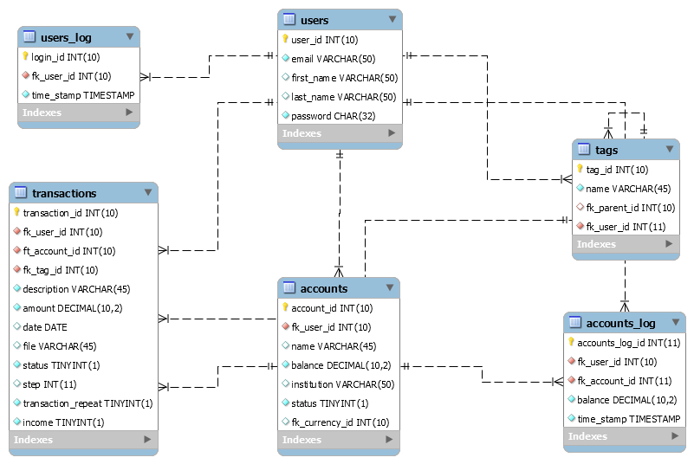
Our DB

Slide 5

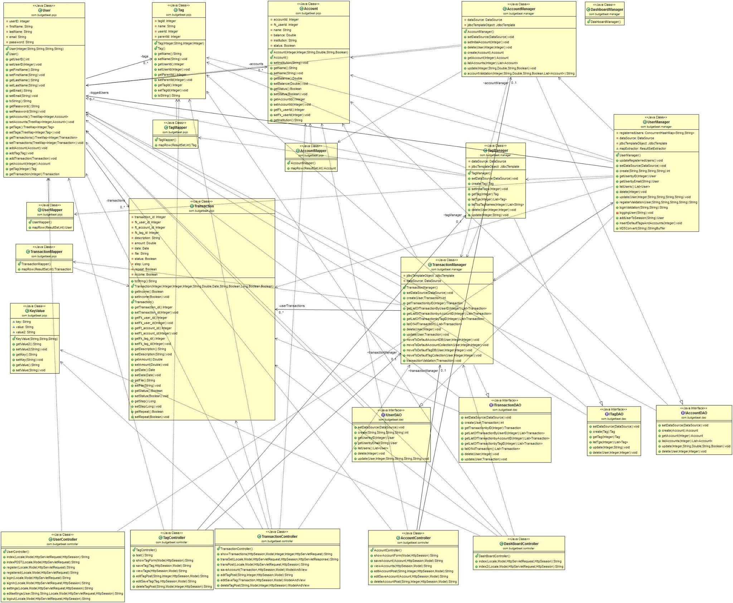
Our OOP

Slide 6

What can it do?
User – CRU
Tag - CRUD
Account - CRUD
Transaction – CRUD
Relations
Reports

Slide 7
Front end
HTML 5
CSS
JS
BOOTSTRAP
Google Charts

Slide 8
Back end
Java EE
Spring beans,
Spring JDBC,
Spring Transactions
Spring Forms
JSTL
JSP
MySQL
TomCat
Maven

Slide 9
Future plans
Transactions from banks account.
Receive real-time alerts on your mobile device if your overspend
Forecast
Full REST API

Slide 10
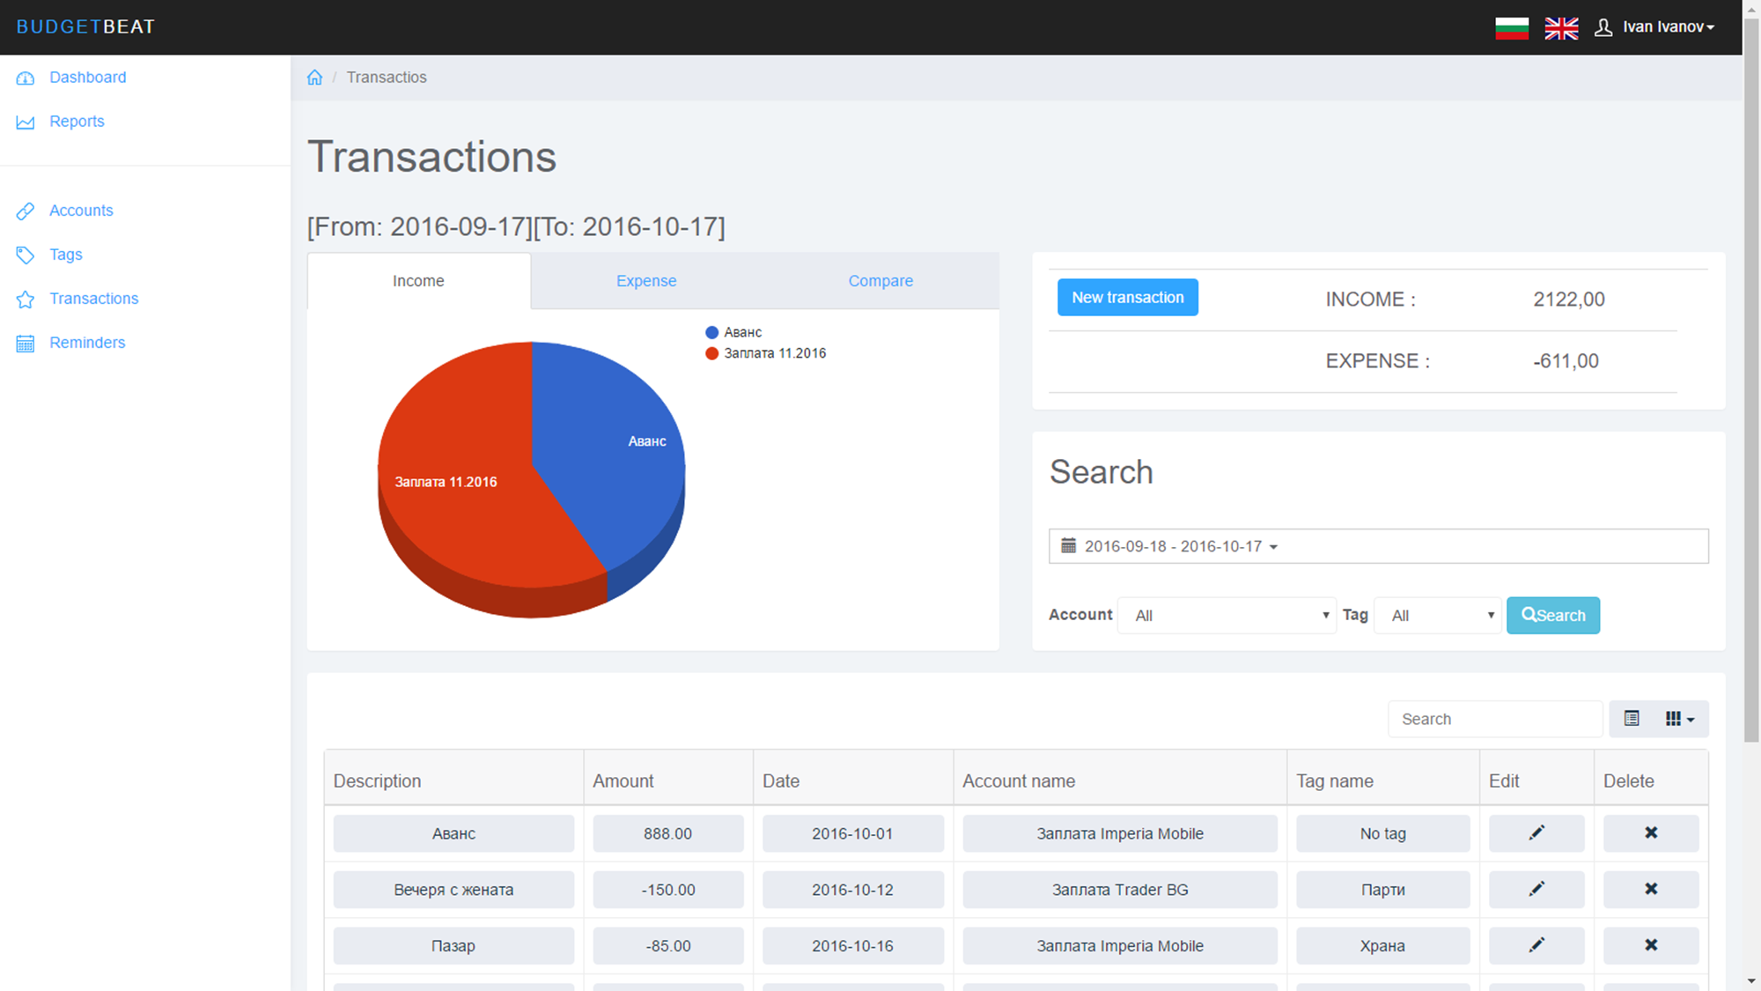
Demo

